Slide 1
Wholesale Customer Classifications

Slide 2
Dataset
The dataset contains annual wholesale customer spendings based on a few categories such as:
Fresh Products
Milk Products
Grocery Products
Frozen Products
Detergents and Paper
Delicatessen Products
Channel
Region

Slide 3
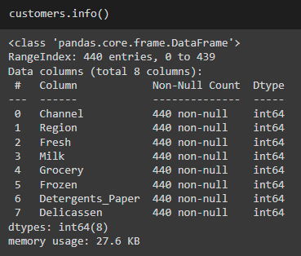
Data Cleansing
The dataset contains 440 of instances and 8 attributes in integers which is perfect for classification and clustering analysis
The data also has no missing values and saves our efforts in cleaning them for analysis
Reference Feature Data points will be use
Fresh
Grocery
The data points can be changed to further
validate the categorical results

Slide 4
The Methods
The purpose of this exercise is to make use of the 3 clustering methods for comparison to determine the reference value (silhouette Score) that will derive from the clustering algorithm.
- KMeans
- Hierarchical
- DBSCAN
The final plan is to make use of the silhouette score to compare and find the most optimal wholesales customer segmentation for marketing use.

Slide 5
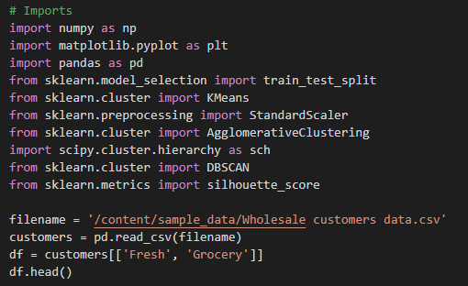

Initialization of Dataset
We make use of the following library imports and scale the dataset:

Slide 6
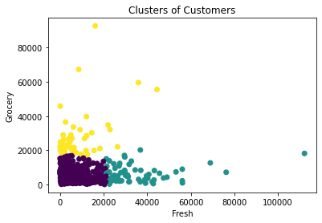
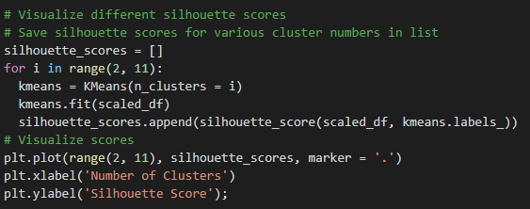
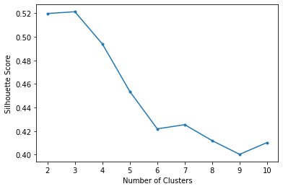
Silhouette Scores of KMeans
Considering there is no way to determine the best categorizations, we use the silhouette scoring and ran through 11 possible categories to get the most optimum categorizations – 3 Categories

Slide 7
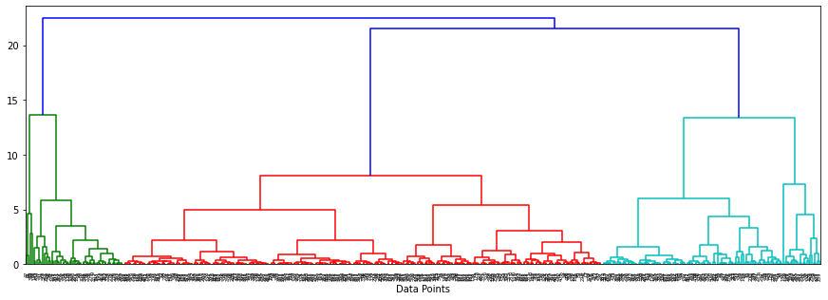
Hierarchical Clustering
Using a dendrogram, graphical data presented seems to show the logical categorization of the data points is between 2-3 groupings.

Slide 8
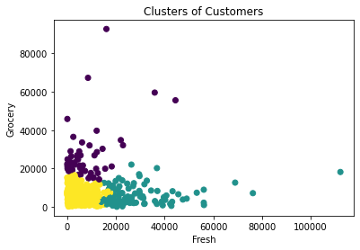
Hierarchical Clustering
Using the hc.labels to visualize the clusters of the customers based on the feature sets Grocery and Fresh product shows (using 3 categories):
The result is pretty consistent with the chart we produced from KMeans
Hierarchical
KMeans

Slide 9
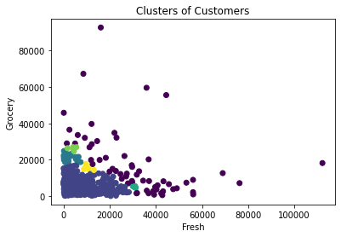

DBSCAN Clustering
For DBSCAN, tweaking the eps and min_samples value produces different clustering visuals. In the example below we used 0.2 and 4 respectively:3
Using DBSCAN is not giving us a clear presentation of the customer segment classification, unlike KMeans and Hierarchical algorithm
Silhouette score is also low using 0.2 and 4 as our eps and min_samples parameters at: 0.10949

Slide 10
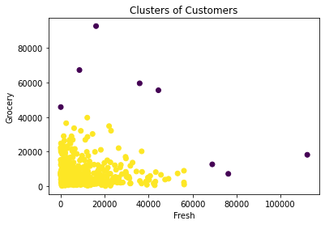
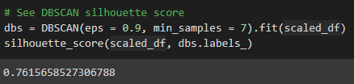

DBSCAN Clustering
Using a different parameter values (eps=0.9 and min_samples=7) we are getting a better silhouette score using DBSCAN:
Using DBSCAN is not giving us a clear presentation of the customer segment classification, unlike KMeans and Hierarchical algorithm

Slide 11
Conclusion
It appears KMeans and Hierarchical Clustering algorithm are giving more consistent results that puts our wholesale customer segmentations at 2 or 3

